Slide 1
COURSE SEARCH ENGINE FOR U of I
CS 410 – Text Information System
Paulami Ray (paulami2)
Garima Garg (garimag2)
Kumkum Yadav (kumkumy2)

Slide 2
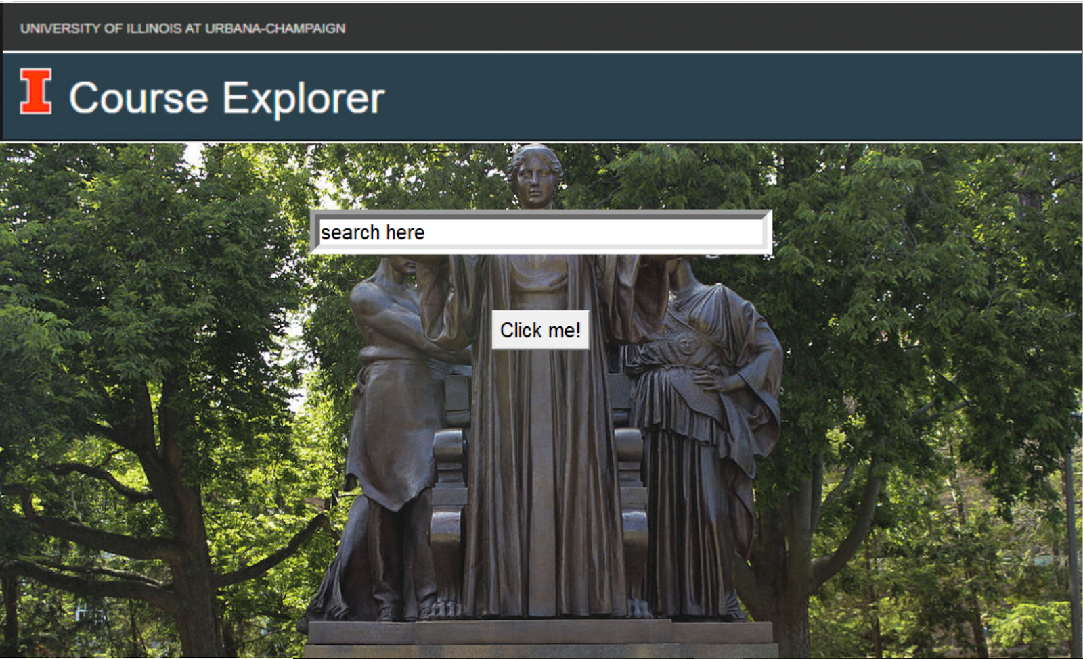
INTRODUCTION
Create a web search engine to search courses of University of Illinois Urbana Champaign.
Course of interest can be searched from the College of Engineering, College of Business, School of Information Sciences & Statistics for Fall 2018.

Slide 3
PROJECT Overview
Motivation: The current course explorer of University of Illinois, Urbana Champaign specializes in term matching. It is equipped to give courses per term, per semester. But it lacks the ability to rank searches based on the user’s input. It does not equip the user with the knowledge of which courses correspond to his or her query but gives all the courses that match the particular user’s input.
Goal: Our model aims at solving the ambiguity of course selection by taking the input from the user and applying appropriate natural language processing techniques. It returns the top 20 courses as per the user query.

Slide 4









SOFTWaRE

Slide 5
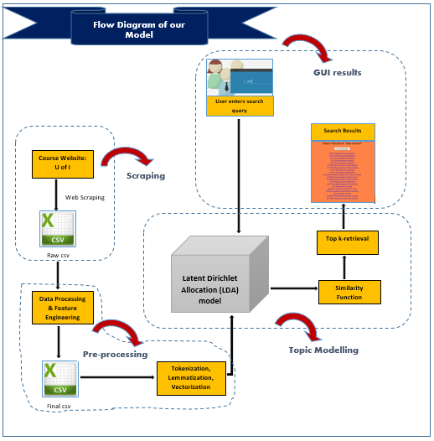
PROJECT PlaN
Web Scraping
Data pre-processing
Topic modelling with LDA
Graphical User Interface

Slide 6
IMPLEMENTation
Web Scraping using Beautiful Soup
Data Processing and Feature Engineering
Tokenization, Lemmatization and Vectorization
Topic Modelling using Latent Dirichlet Allocation (LDA)
User enters search query
Using Similarity Function for grouping
Top 20 topic retrieval
Display Search Results

Slide 7
PROCESS DEMO & RESULTS

Slide 8
FUTURE SCOPE
We can use the user’s resume and extract words from them making a personalized dashboard of courses for the user best suited with his or her profile.
We could also add a recommender system with some initial interests taken from the user and map those interests to recommend similar courses to the user.

Slide 9
CONCLUSION
The model successfully captures the top 20 documents related to a user’s query. We start off with analysing the capabilities in the existing search model and then think of ways to implement a search engine based on user’s query. The model uses various techniques like scraping, data preprocessing, topic modelling and GUI development.

Slide 10
THANK YOU

